Slide 1

Winner trades all –
NVIDIA stock prediction
Apple
Ben
Simon
20241209 Winner trades all – NVIDIA stock prediction

Slide 2
Outline
Motivation
How to do
Data Source
Key Features
Models
Flow chart
Trading strategy
Result
Conclusion
Winner trades all – NVIDIA stock prediction

Slide 3
Motivation
Why NVIDIA?
NVIDIA’s leading role in AI and high-performance computing
The impact of stock price fluctuations on technology companies
Leveraging ML for improved price prediction accuracy
Objective
Assess the performance of ML techniques in forecasting whether NVIDIA's stock price will rise or fall on the next trading day.
Winner trades all – NVIDIA stock prediction

Slide 4
How to do
Data Source
NVIDIA historical stock data (Jan. 2010 – Sep. 2024)
Split the data (70% for training, 30% for testing)
Source: Bloomberg
Key Features
High, low, open, and close prices
Trade volume, volatility, and technical indicators (ex: RSI, MACD)
Winner trades all – NVIDIA stock prediction

Slide 5
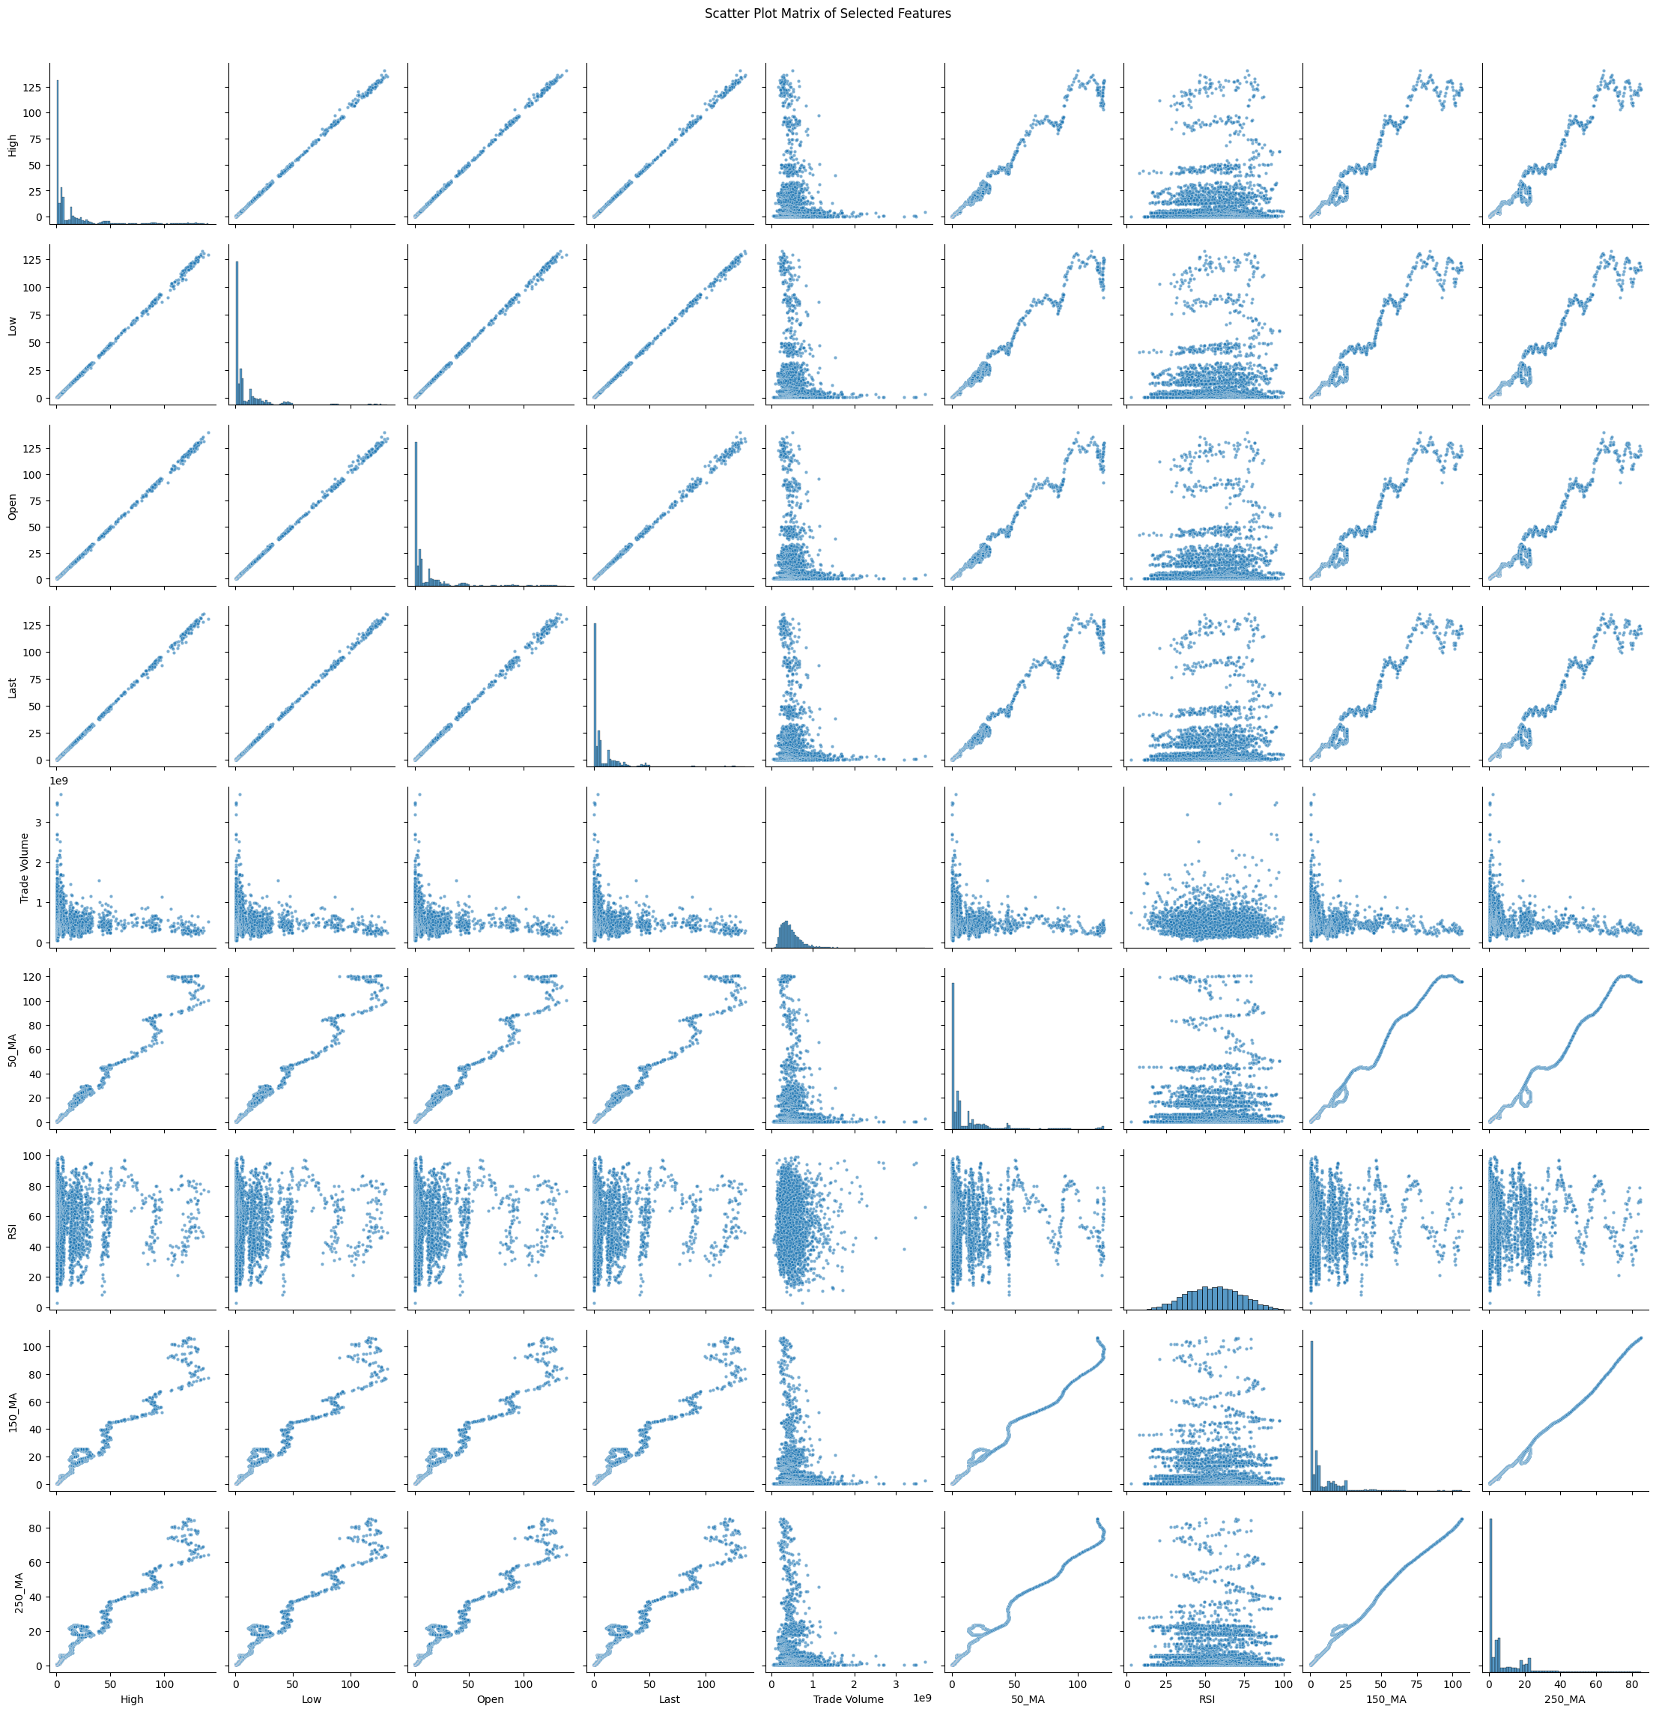
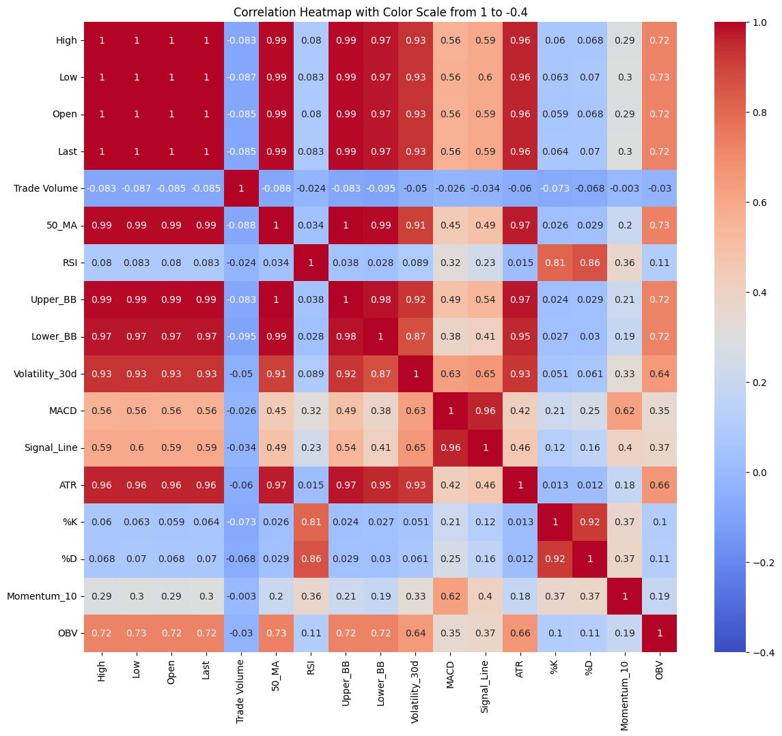
How to do-features
Winner trades all – NVIDIA stock prediction

Slide 6
How to do
Models
Logistic Regression: Simple and interpretable
Random Forest: Robust for high-dimensional data
XGBoost: Powerful boosting algorithm, refines predictions by correcting errors from prior iterations
Winner trades all – NVIDIA stock prediction

Slide 7
How to do
Research Workflow
Data cleaning and handling missing values
Feature engineering and model training (testing three models)
Results evaluation: Comparing accuracy to the NDX Index
Simulating an investment strategy
Winner trades all – NVIDIA stock prediction

Slide 8
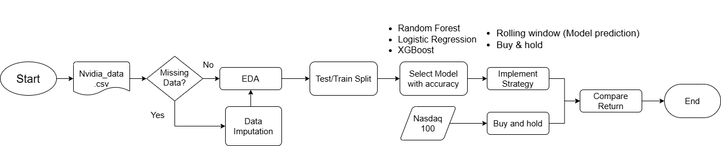
How to do
Flow chart
Winner trades all – NVIDIA stock prediction

Slide 9
How to do
Trading strategy: Buy all & sell all
Rolling window
*Note that: Indicator is the prediction of “today’s going”
Winner trades all – NVIDIA stock prediction

Slide 10

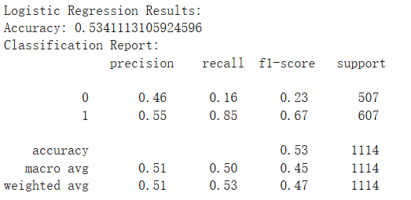
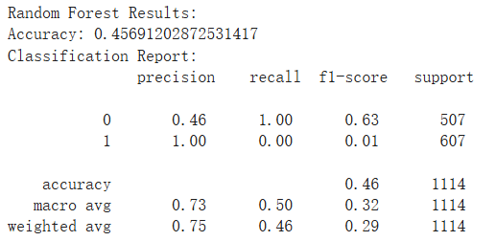
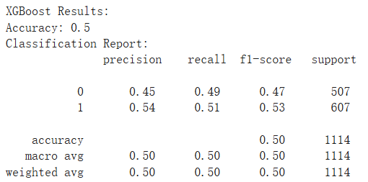
Result
Accuracy of Models
Logistic Regression: 53.4%
Random Forest: 45.6% < 50%
XGBoost: 50%
Winner trades all – NVIDIA stock prediction

Slide 11
Result
Initial Balance | $10000
Final Balance | $198716.37
Total Return | 1887.16%
Trading period | From 2020-04-29 to 2024-10-01
Total number of trades executed | 301
Winner trades all – NVIDIA stock prediction

Slide 12
Result-comparison
Trading period: From 2020-04-29 to 2024-10-01
 | Nvidia (Strategy) | Nvidia (Stock price) | Nasdaq (Index)
Initial Balance | $10000 | $7.46 | 8982.76
Final Balance | $198716.37 | $109.54 | 19773.3
Total Return | 1887.16% | 1368.36% | 120.12%
Winner trades all – NVIDIA stock prediction

Slide 13
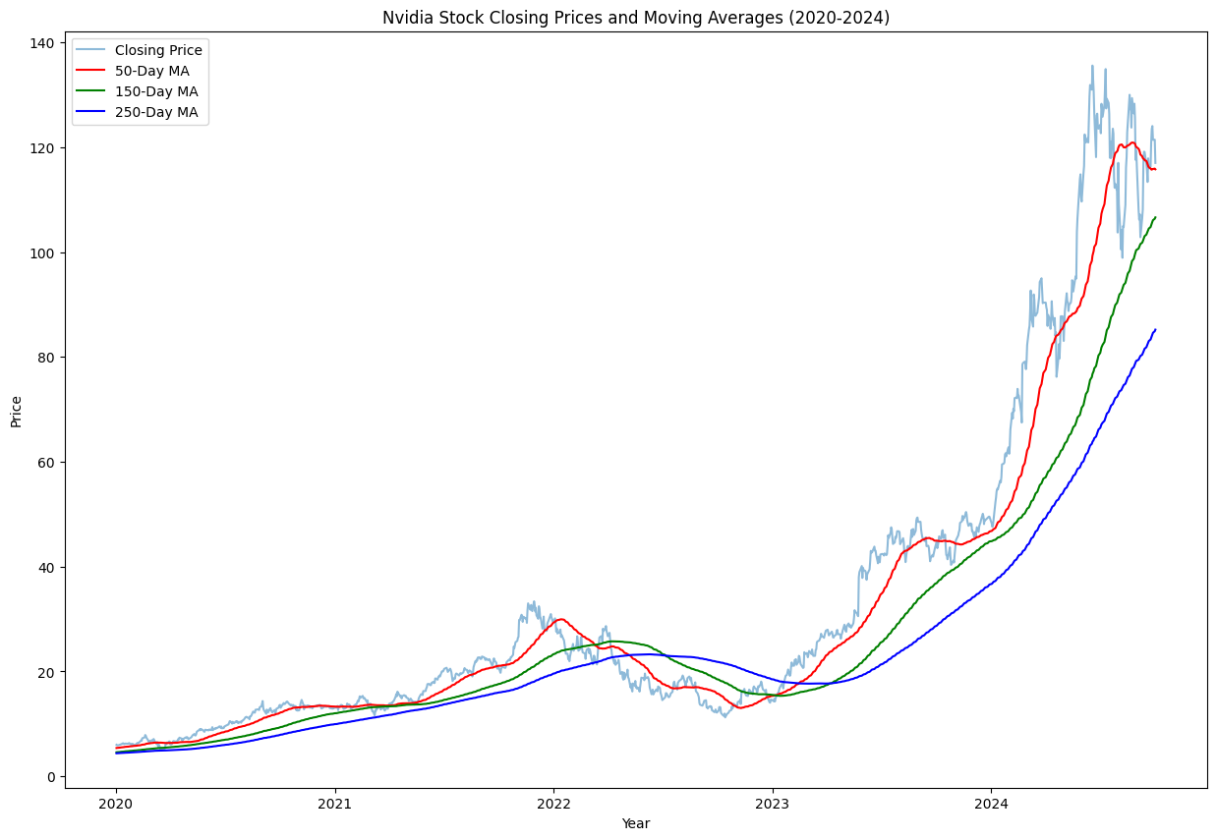
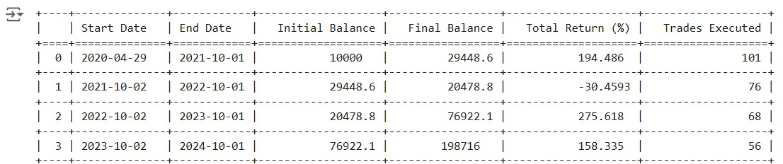
Result
Advanced Analysis
Segment the test period into one-year intervals
 | Nvidia (Strategy) | Nvidia (Stock price)
Initial Balance | $29448.6 | $19.732
Final Balance | $20478.8 | $12.512
Total Return | -30.46% | -37.60%
Winner trades all – NVIDIA stock prediction

Slide 14
Section Title
Conclusion
Total Return: Nvidia(Strategy) > Nvidia(Stock price) > Nasdaq
An accuracy of 53.4% yields a return exceeding 1000%
Generate greater profits in a rising market and minimize losses in a declining market
Further study:
i) improve feature selection and hyperparameter tuning
ii) Apply to another technological stocks
Winner trades all – NVIDIA stock prediction

Slide 15
Winner trades all –
NVIDIA stock prediction
Apple
Ben
Simon
20241209 Winner trades all – NVIDIA stock prediction

